Slide 1
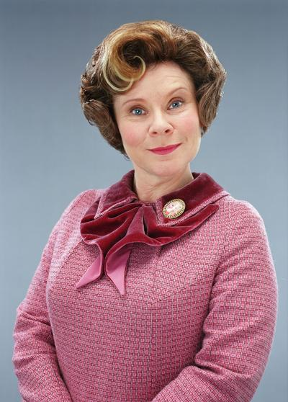
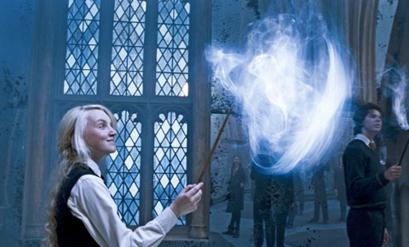
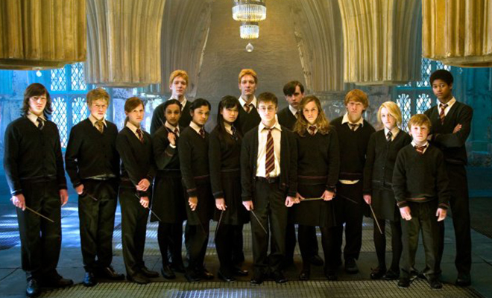
Harry Potter and the Order of the Phoenix

Slide 2
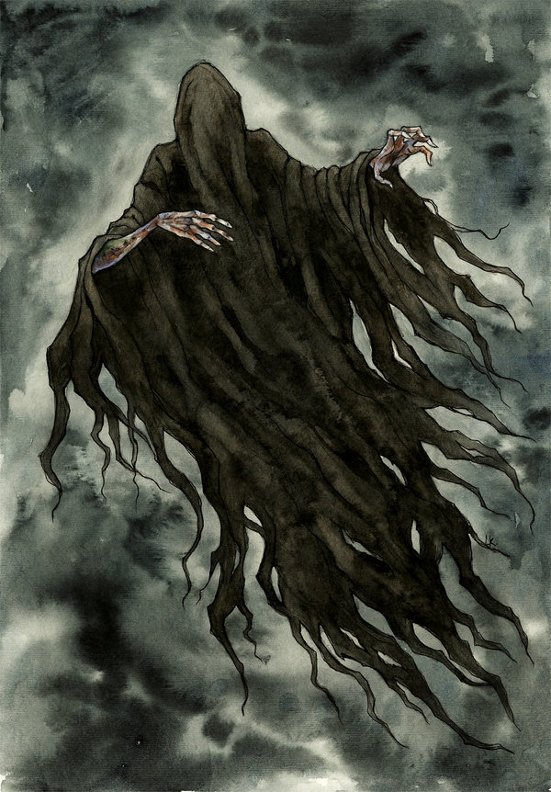
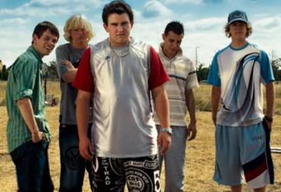
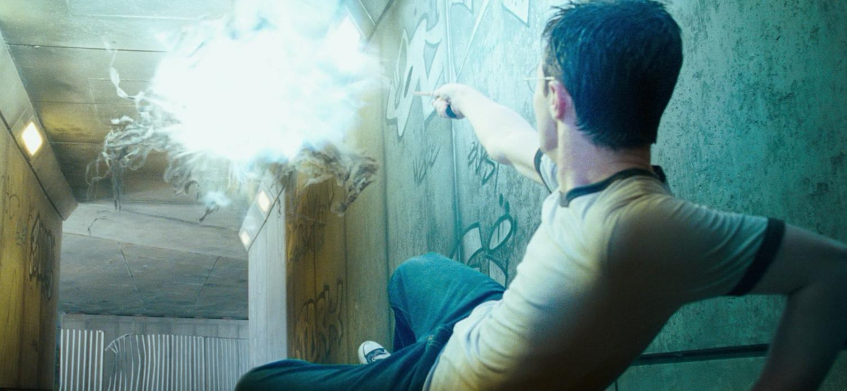
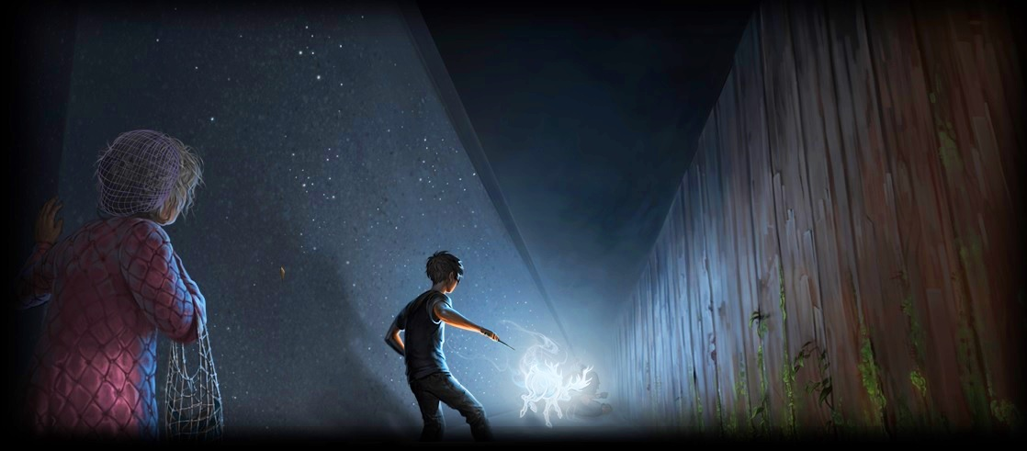
The dementors
In the first of the book Harry is with Dudley and dementors come, so Harry uses magic in the muggle world

Slide 3
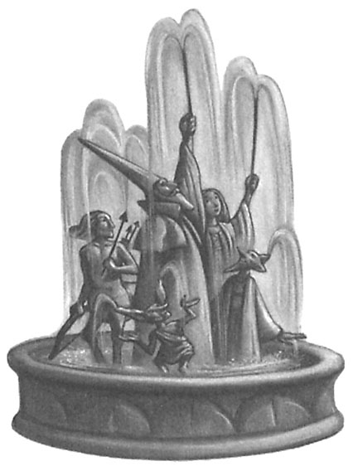
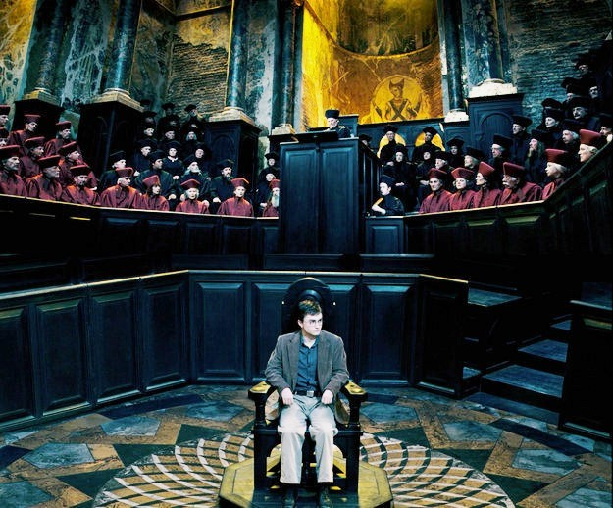
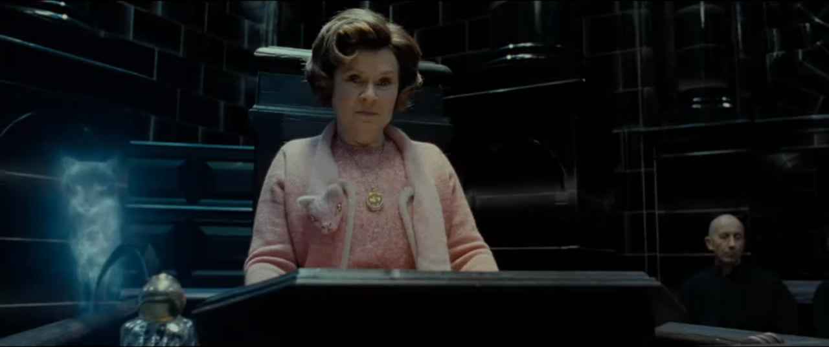
Ministry of Magic
Harry gets in trouble for using magic in the muggle world. He gets Set out of Hogwarts but Dumbledore helps him win the trial and be able to go back to Hogwarts.

Slide 4
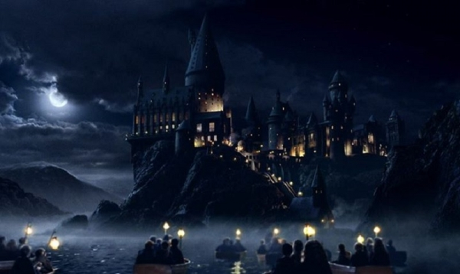
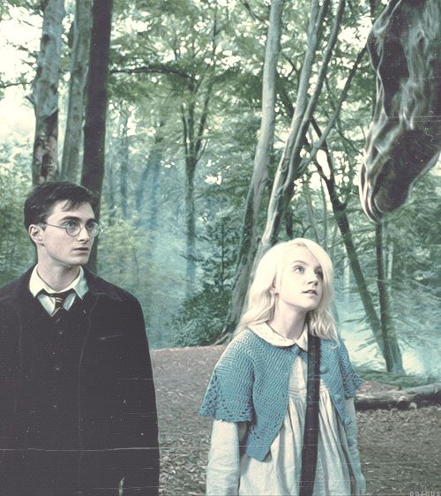
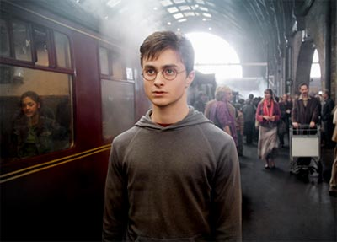
Hogwarts
Since Harry won the trail at the ministry of Magic he is able to go to Hogwarts on his way there he and Luna met some magical creatures called Thestrals.

Slide 5
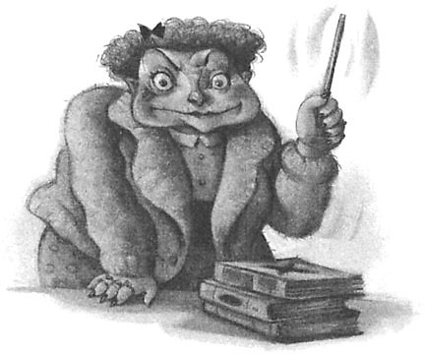
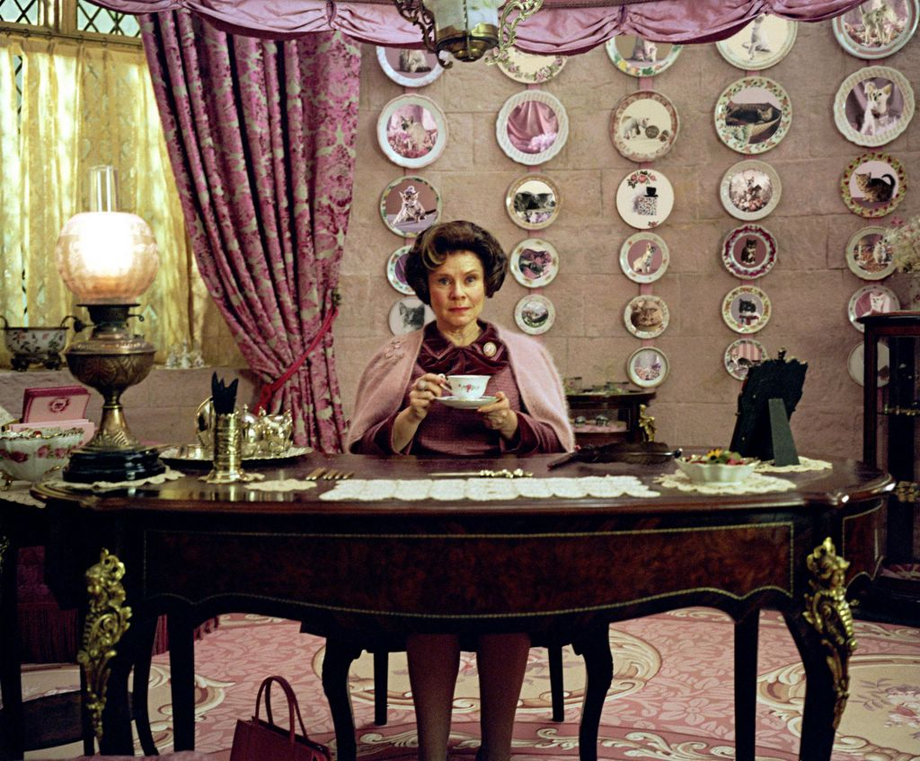
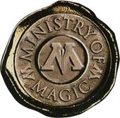
Professor Umbridge
Professor Umbrige is the new Defense Against the Dark Arts teacher at Hogwarts, she is sent from the Ministry of Magic. She becomes Headmaster of Hogwarts and creates many rules! She isn’t to fond of Harry and Harry HATES her.

Slide 6
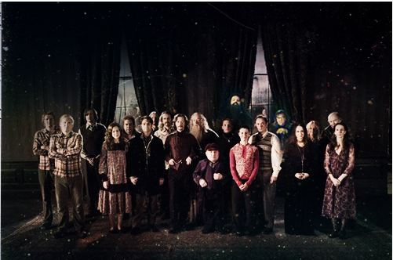
The Order of the Phoenix
Harry finds out about the order of the Phoenix, a secret society made by Harry’s parents, Neville's parents, Sirius Black and many others.

Slide 7
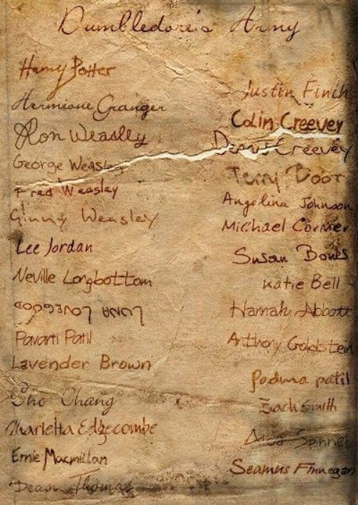
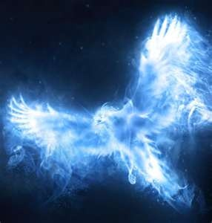
Dumbledore’s Army
Harry creates a secret club called Dumbledore’s Army, or the DA for short, that consists of students at Hogwarts that want to learn how to defend themselves against the dark arts. Harry potter teaches them how to do defend themselves.

Slide 8
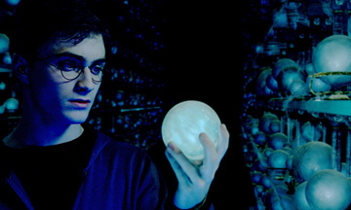
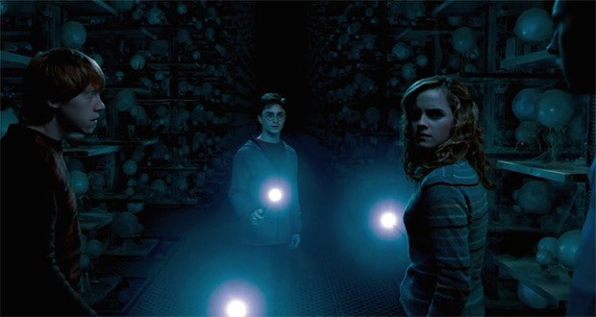
Battle at the ministry
The DA, or Dumbledore’s army travel to the Ministry of Magic to save Sirius Black, Harry’s Godfather. When they find out it was a trick, a battle breaks out between Voldemort’s followers, also known as Death Eaters, and the students from the DA.

Slide 9
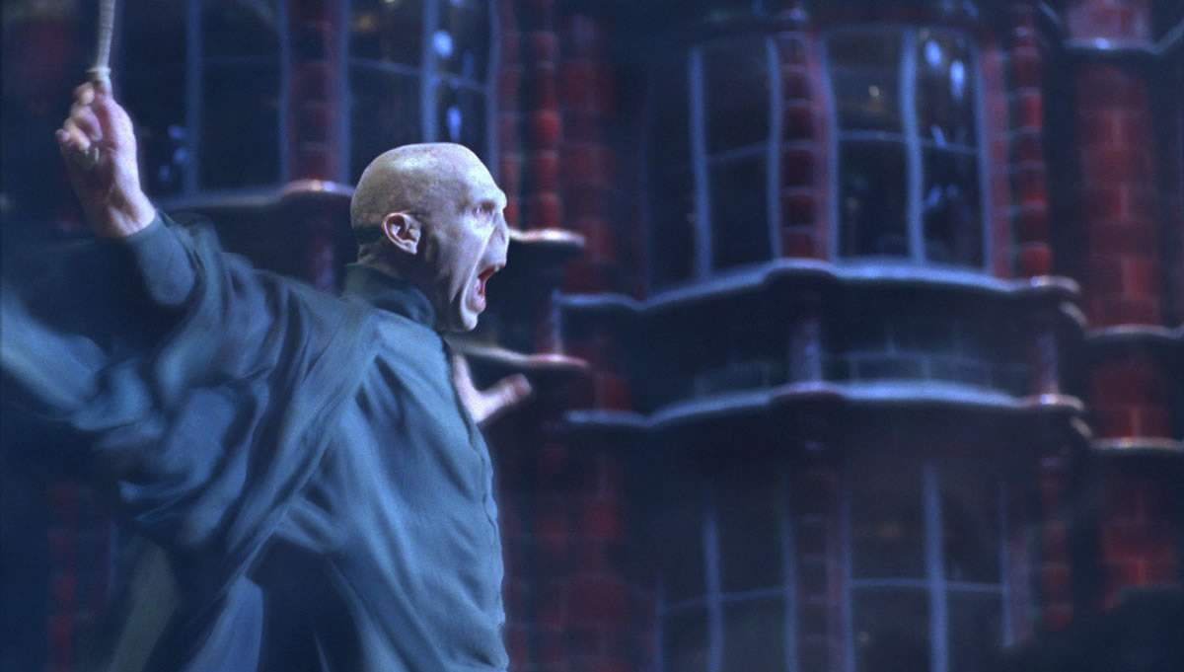
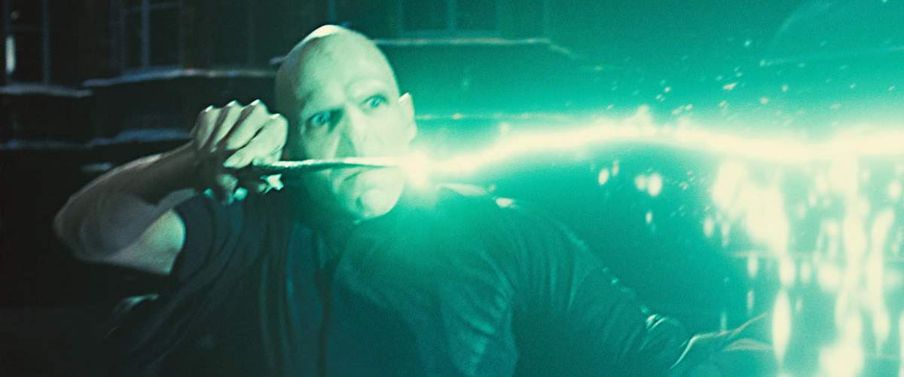
Voldemort
Voldemort and his followers come to the Ministry of Magic and fight Harry and the rest of Dumbledore's Army! This is a high action Part!

Slide 10
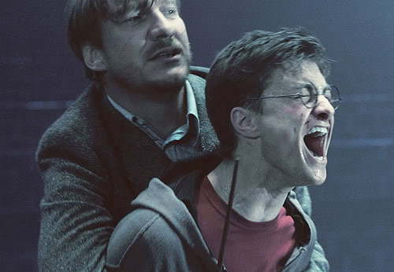
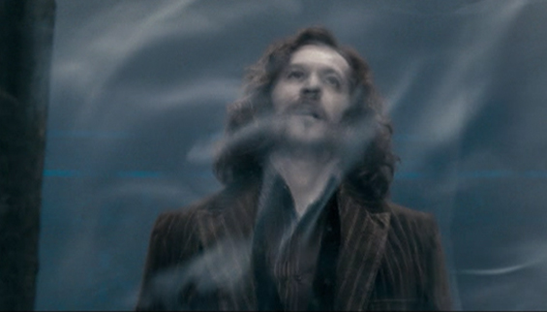
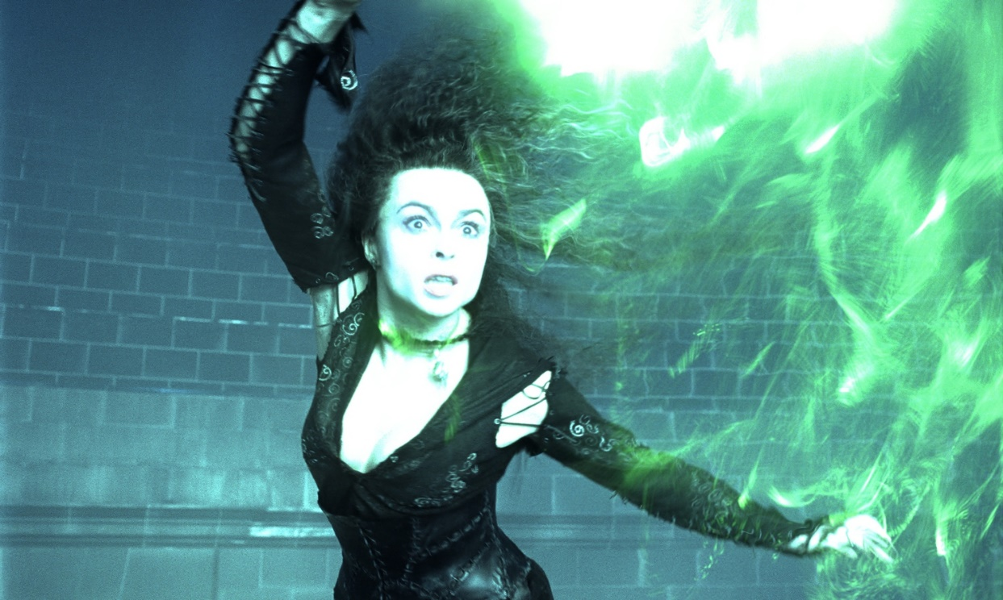
Sirius Black’s death
Sirius Black is Harry’s godfather. While at the Ministry, Sirius Black and some of the members of the Order of the Phoenix come to help the DA fight Voldemort and the Death Eaters. Bellatrix Lestrange kills Sirius, making Harry super sad. Harry asks a ghost at Hogwarts if Sirius will come back as a ghost, but the ghost says he won't, making Harry still feel very sad.

Slide 11
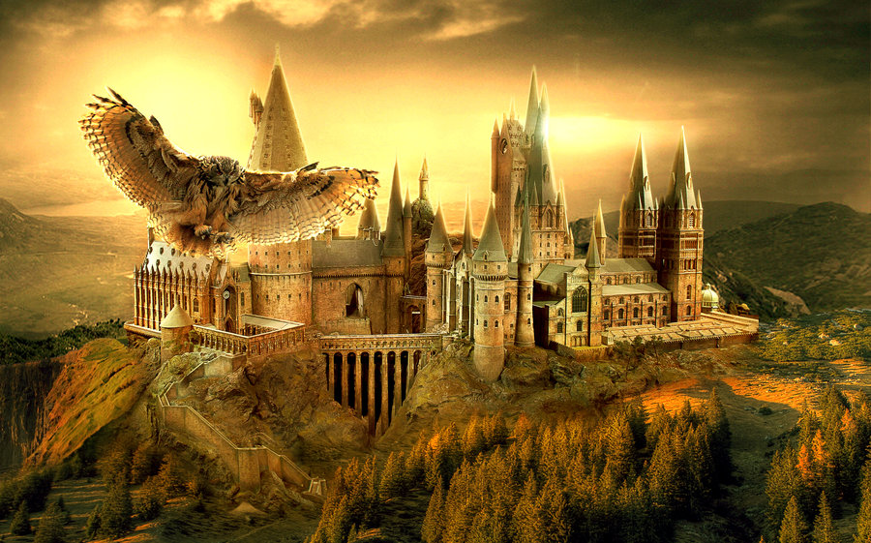
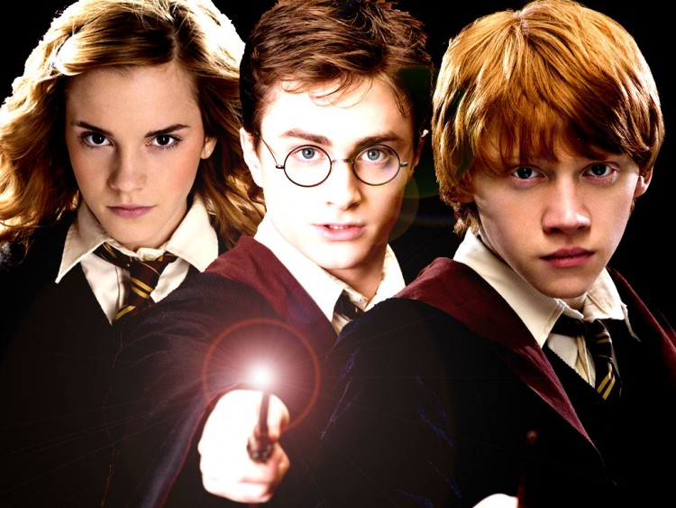
Returning to Hogwarts
After the battle at the Ministry, Harry and his friends return back to Hogwarts to finish their schooling.

Slide 12
Everyone becomes happy again, except Harry because Sirius is dead and that is sad, but Harry will feel better eventually. The end!

